Slide 1
Project Report
After analyzing PSW data set we have some findings regarding Big Mountain Resort and based on that we have some recommendations.

Slide 2
Findings
Initially with the dataset we noticed the Big Mountain Resort data falls in a outlier portion.
So, after training our model out model predicted the Adult Weekend price for Big Mountain Resort should be near
73.08 dollars where currently it was charging 81 dollars.

Slide 3
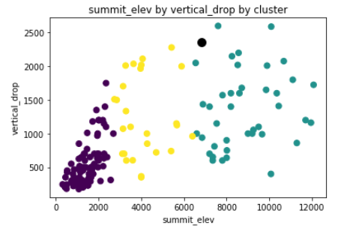
Clusters distribution of PSW data

Slide 4
The black dotted cluster is Big Mountain Resort data and shows where it fits in data clusters.

